Slide 1





Hotel Booking Behavior Analytics: Trends & Revenue Impact
Team : Mohammed Ziyad Kakhandkikar Guide : Mario Thokchom
Mail id : mjkakhandkikar@gmail.com
Disclaimer: The content is curated for educational purposes only.
Notes:
Slides: Prepare a short slide deck (10-12 slides) summarizing the project objectives, methodology, and key results.

Slide 2
OUTLINE
Abstract of the Project
Problem Statement
Proposed Solution
System Architecture
Conclusion
Future Scope

Slide 3
Abstract
This project analyzes hotel booking data to uncover trends in cancellations, revenue, and customer behavior. Using data visualization and aggregation, we explore factors like lead time, ADR, distribution channels, and special requests to optimize hotel operations and enhance customer satisfaction.
Problem Statement
Hotels face challenges in cancellations, revenue management, and demand forecasting. This study aims to identify:
Key factors affecting cancellations and booking patterns.
The most and least profitable distribution channels.
How special requests impact customer experience.

Slide 4
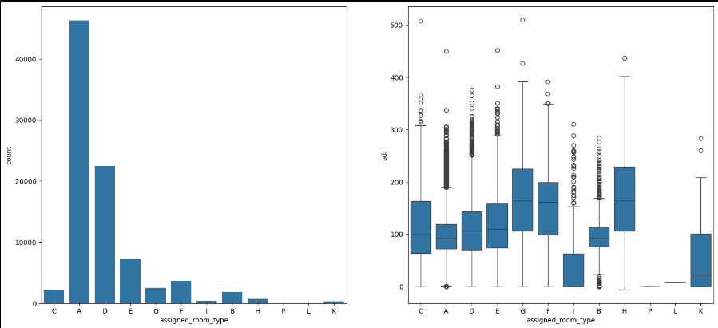
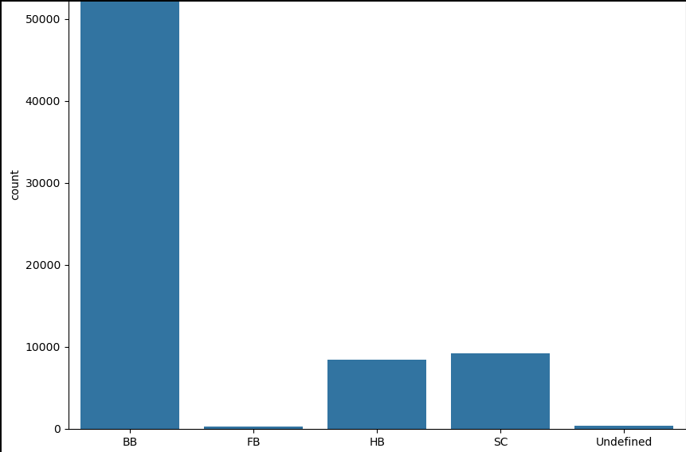
• Type A room is most demanded by customers.
• Room types C, G and H are some of the highest adr(average daily rate) generating rooms.
• Most preferred meal type is BB( Bed and breakfast).

Slide 5
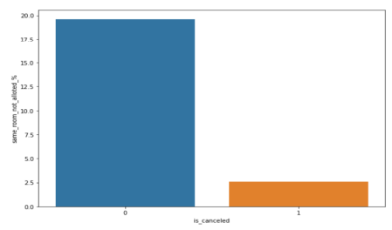
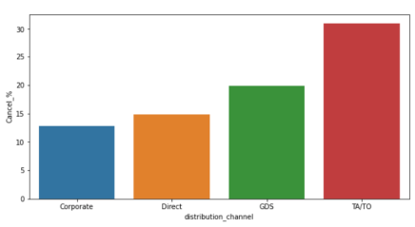
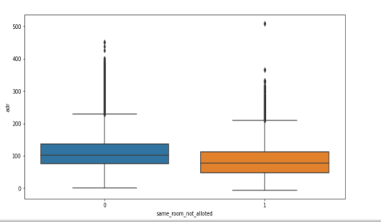
Booking cancellation Analysis
• TA/TO has highest booking cancellation %. Therefore, a booking via TA/TO is 30% likely to get cancelled.
• Not getting same room as demanded is not the case of cancellation of rooms. A significant percentage of bookings are not cancelled even after getting different room as demanded.
• But, customers who didn't got same room have paid a little lower adr, except for few exceptions.

Slide 6
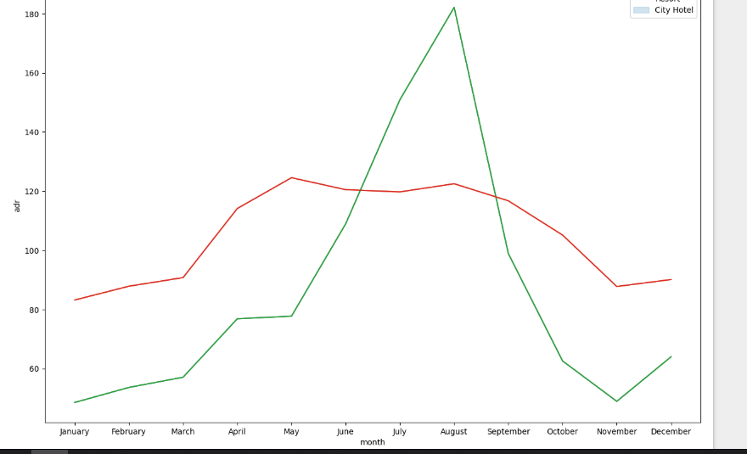
Proposed Solution
✅ Stricter cancellation policies for long lead-time and TA/TO bookings. ✅ Deposit requirements or pre-payment discounts to secure reservations. ✅ Encourage direct bookings over third-party channels. ✅ Loyalty incentives to retain repeated guests. ✅ Flexible ADR-based pricing to reduce price-sensitive cancellations. ✅ Engage customers post-booking with reminders and personalized offers.
The revenue aspect looks different, the Resort Hotels receives more revenue with respect to City Hotel. From May to August there was rapid increase in adr. August recorded the highest

Slide 7
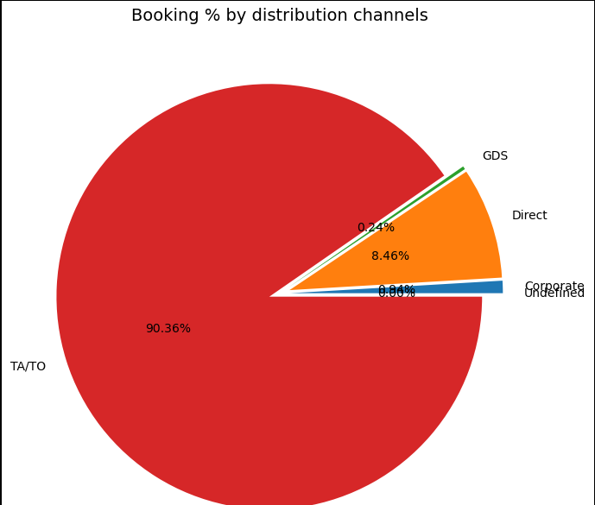
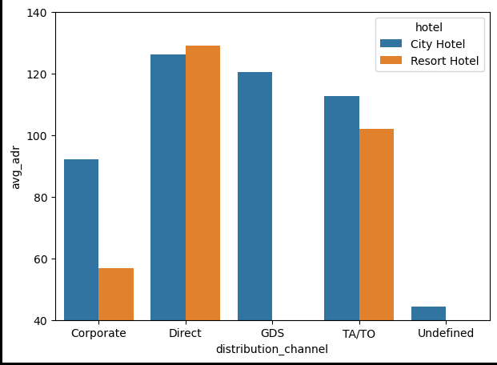
Distribution channel
• Here we can see that the most of guest are making reservation through TA/TO channels which is travel agency and tour operator.
GDS (Global Distribution System) Channel
● GDS channel brings higher revenue generating deals for City hotel, in contrast to that most bookings come via TA/TO. City Hotel can work to increase outreach on GDS channels to get more higher revenue generating deals.

Slide 8
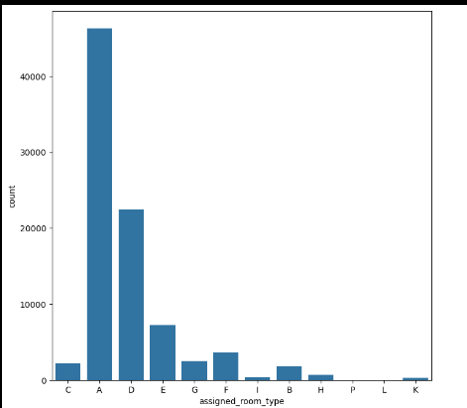
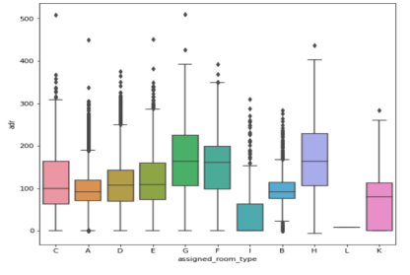
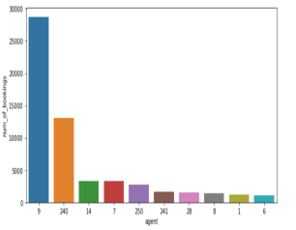
Analysis
• Type A room is most demanded by customers.
• Room types C, G and H are some of the highest adr(average daily rate) generating rooms.
• Agent with id no. 9 made most of the bookings.

Slide 9
System Architecture
The system architecture for hotel booking analysis is structured into multiple layers to ensure efficient data processing, analysis, and visualization.
1. Data Source Layer:
Hotel booking dataset (CSV, SQL)
External data sources (if applicable)
2. Data Processing Layer:
Data Cleaning & Transformation: Handling missing values, converting categorical data
Feature Engineering: Creating meaningful variables for analysis
3. Analytical Layer:
Booking Trends Module: Identifies Room Type A as the most demanded
Revenue Optimization Module: Finds that Rooms C, G, and H generate the highest ADR (Average Daily Rate)
4. Business Intelligence Layer:
Predictive Analytics: Forecasting future booking trends
Customer Segmentation: Identifying frequent vs. one-time guests
5. Visualization Layer:
Graphical Insights: Visualizing ADR trends, agent performance, and room demand

Slide 10
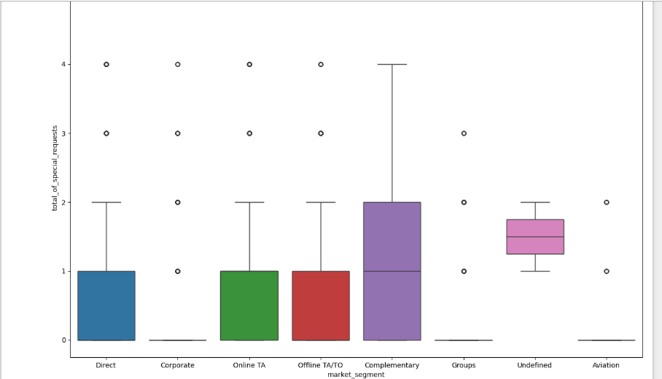
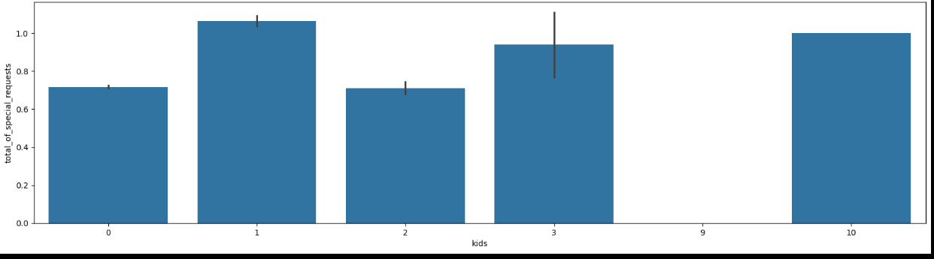
Reasons for special requests
The number of special request are almost the same in the kids section. But, we can see that if the adults are more than 2 there are more chances that hotels will receive more special requests.
Here we can see that all market segment mostly have special request

Slide 11
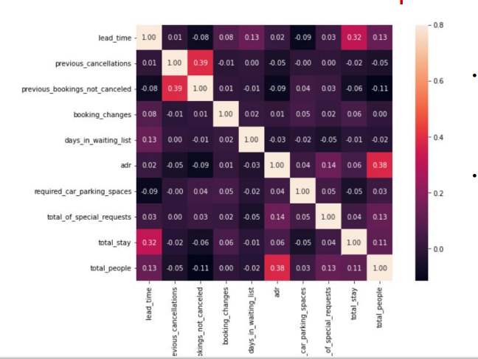
Correlation Heatmap
• We may observe that total stay length and lead time are slightly correlated. This may means that for longer hotel stays, people generally plan little before the actual arrival.

Slide 12
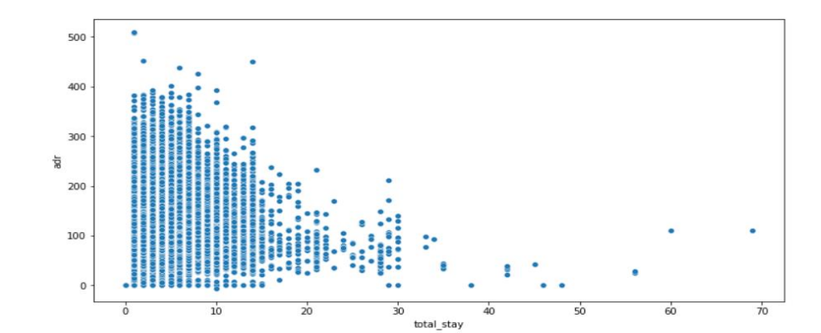
Optimal stay length
For shorter stays the adr(average daily rate varies greatly) but for longer stays adr is comparatively very less. Therefore, customers can get better deal for longer stays more than 15 days.

Slide 13
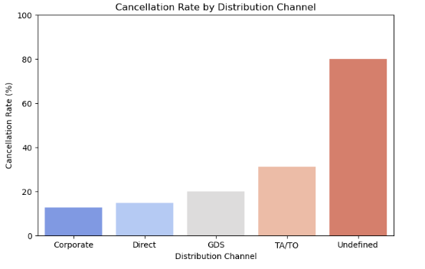
Future Scope
Predicting Cancellations Using Machine Learning
Optimizing Pricing Strategies
Enhancing Customer Retention
Improving Distribution Channel Performance
Notes:
thank you very much for joining this PPT, keep learning.
13

Slide 14
Conclusion
● More number of people in guests results in more number of special requests.
● Almost 30% of bookings via TA/TO are cancelled.
● July- August are the most busier and profitable months for both of hotels.
● Around 60% bookings are for City hotel and 40% bookings are for Resort hotel, therefore City Hotel is busier than Resort hotel. Also the overall adr of City hotel is slightly higher than Resort hotel.
● Within a month, ADR(Average Daily Rate) gradually increases as month ends, with small sudden rise on weekends.

Slide 15
Thank You

